Slide 1
SALT CORPORATION HR ANALYSIS
Employee Satisfaction & Retention Analysis 2024
PRESENTED BY: JESICA AKEYO OGINDO

Slide 2
DATASET OVERVIEW
Records: 1,000 employess | Fields: 24 columns | Period: 2018 – 2020 | Departments: 5 | Positions: 5
Column | Issue | Solution | Result
Age | Text Values eg. “Thirty”, missing values | Recalculated using 2024 – Birth Year | Avg age = 36
Salary | “SIXTY THOUSAND” text, “NAN”strings | IF to convert text, AVERAGEIFS by dept and position to fill missing | Avg salary= 60,207.70
Department | Inconsistent casing e.g. finance , FINANCE | PROPER function, IF for IT and HR | Consistent casing for all categories
Joining Date | Mixed formats | DATE, LEFT, MID, RIGHT to extract and rebuild dates | Uniform date format: dd/mm/yyyy
Email | Missing values | TRIM then LOWER(CONCAT(first, last,@saltcorp.com)) | Valid emails across all rows
Benefits | Inconsistent Yes/No and blanks | IF and OR logic to standardize, blanks = Unknown | Only Yes, No, Unknown values

Slide 3
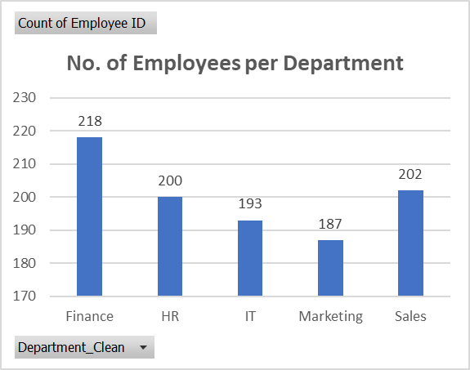
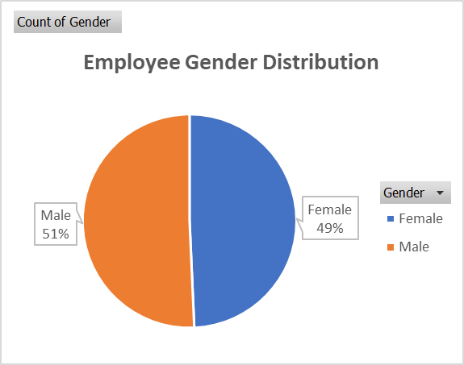
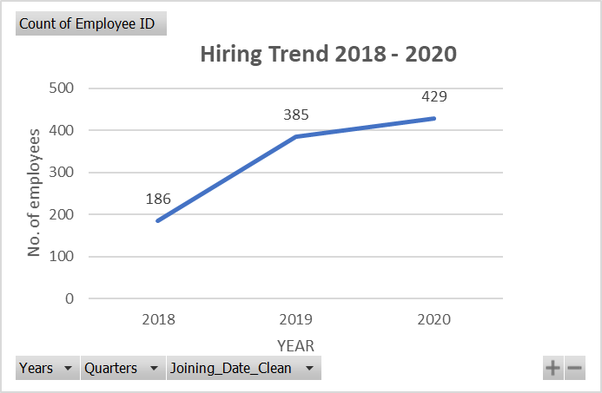
WHO ARE OUR EMPLOYEES
Salt Corporation employs 1,000 people across 5 departments, with Finance being the largest at 218 employees and Marketing the smallest at 187
Gender representation is near equal, with 50.7% male and 49.3% female employees, suggesting inclusive hiring
All five positions are evenly distributed, with Assistants being most common at 214 and Managers least common at 186
Average employee age is 36 years with an average tenure of 5 years, indicating a relatively young and mid-career workforce
Hiring was steady across 2018–2020, suggesting organization growth
Overall, Salt Corporation has a balanced and steadily growing workforce. The next step is understanding how employees experience the organization and how those experiences shape retention.

Slide 4
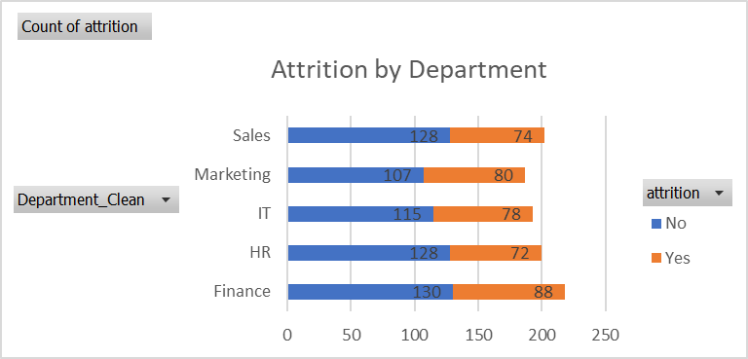
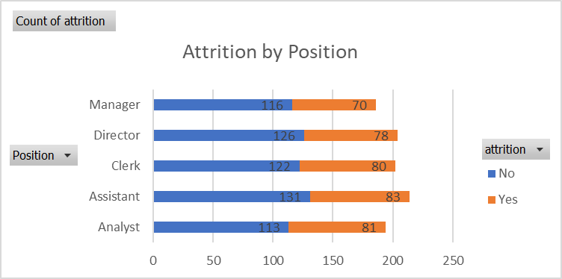
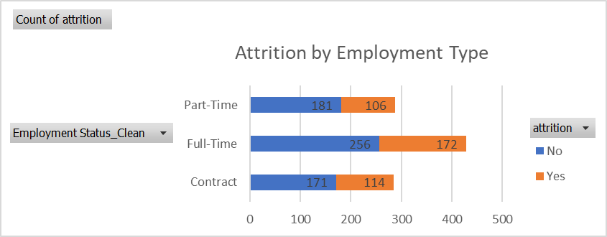
We Have A Retention Problem
Salt Corporation has a 39.2% attrition rate
Attrition is spread across all five departments, with Marketing having the highest rate at 42.8% and HR the lowest at 36% ,suggesting this is not a department-specific problem but a company-wide one
Attrition is equally consistent across all positions, ranging from 37.6% among Managers to 41.8% among Analysts
Employment type shows no significant difference : Contract employees leave at 40%, Full-Time at 40.2% and Part-Time at 36.9%
Attrition remains consistent across all Years of service at 39% whether an employee has been with the company 1 year or 8 years , meaning Salt Corporation is not just losing new hires, it is losing experienced staff too
The consistency of attrition across departments, positions, employment types and years of service points to a systemic, organisation-wide problem.

Slide 5
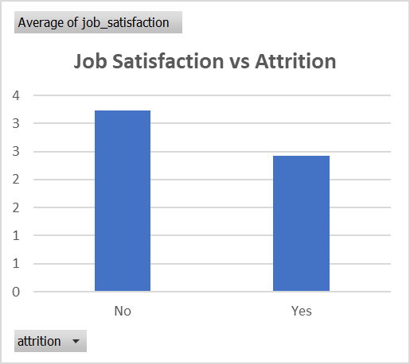
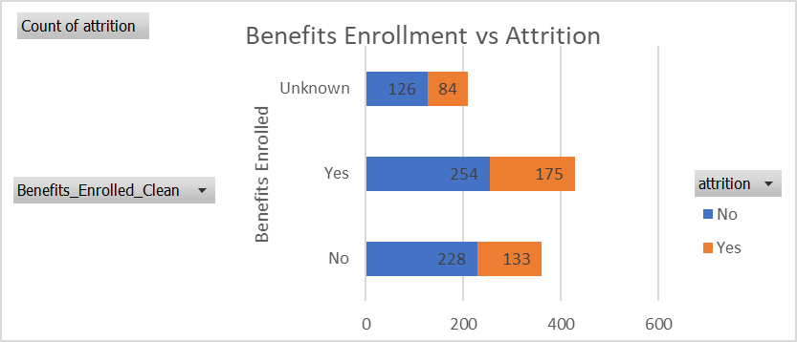
What is Driving It?
Employees who left Salt Corporation had an average job satisfaction score of 2 out of 5, compared to 3 out of 5 among those who stayed, making job satisfaction shows the strongest association with attrition in this dataset.
Satisfaction is uniformly average across all departments and positions, all scoring exactly 3 out of 5 — meaning dissatisfaction is not concentrated in one team or role but is felt company-wide
Less than half the workforce, only 42.9%, is enrolled in benefits
Employees enrolled in benefits and those not enrolled leave at the same rate of 40%, meaning the current benefits package is not keeping people
Across all departments and roles, satisfaction consistently emerges as the one factor that separates employees who stay from those who leave.

Slide 6
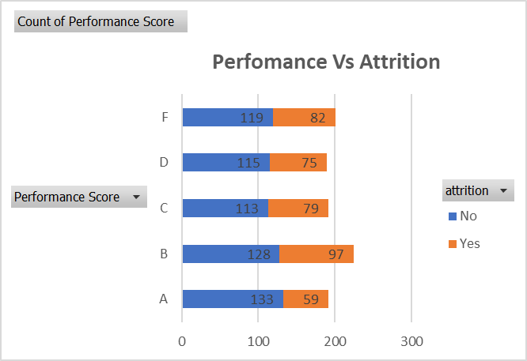
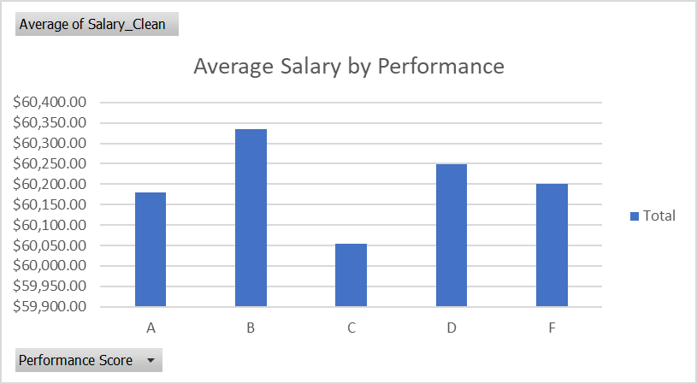
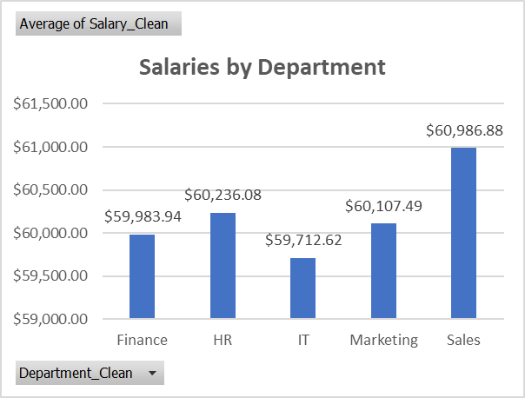
Are We Losing Our Best People?
A performers have the lowest attrition rate at 30.7%, meaning Salt Corporation's strongest employees are the most likely to stay, which is a positive signal
However B performers, our second strongest group, have the highest attrition at 43.1%
Looking at salaries, an A performer earns an average of $60,179 while an F performer earns $60,201 which is virtually the same, meaning that salary is not tied to performance
Finance, despite being the largest department at 218 employees, pays the second lowest average salary, this may be contributing to its 40.4% attrition rate
When good performers see that working hard makes no difference to their pay, they stop feeling valued and they leave

Slide 7
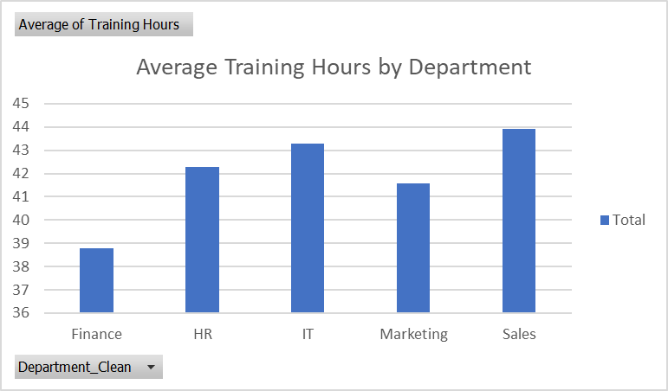
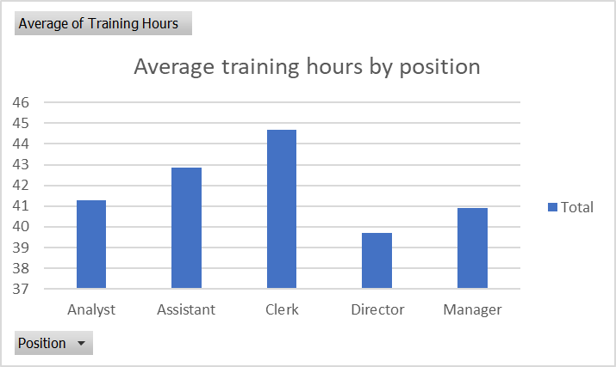
Are We Investing In Our People?
Employees receive an average of 42 training hours per year, roughly one week of development across the whole year
Finance receives the least training at 39 hours, the same department carrying the second lowest salary and a 40.4% attrition rate, suggesting a pattern of underinvestment in that team
Sales receives the most training at 44 hours, yet still carries a 36.6% attrition rate, showing that training alone is insufficient without addressing satisfaction
Directors receive the least training at 40 hours while Clerks receive the most at 45 hours, meaning the leaders who most influence team culture and morale receive the least development investment
Salt Corporation is investing in its people through training, and with smarter targeting of that investment toward Finance and senior leadership, the impact on satisfaction and retention could be significant.

Slide 8
KEY FINDINGS: What The Data Tells Us
Salt Corporation has a retention crisis - 39.2% of employees have left and it cuts across equally in every department, position and employment type
Satisfaction drives attrition - Employees who leave score satisfaction at 2 out of 5. Those who stay score 3
Performance deserves better reward - The best and worst performers earn almost the same salary, leaving top talent feeling undervalued
Finance is doubly disadvantaged - the largest department carries the second lowest average salary and the second lowest training investment, creating conditions where dissatisfaction is almost inevitable
HR programs are not working as retention tools - benefits enrollment stands at 42.9% and has zero measurable impact on attrition, suggesting the current offering does not resonate with employee needs

Slide 9
RECOMMENDATIONS
Address satisfaction at the individual level The data shows satisfaction is consistently low across all departments and roles. Salt Corporation should conduct structured exit interviews and anonymous pulse surveys to understand the specific, individual-level drivers of dissatisfaction.
Introduce merit-based compensation Currently pay is determined by department and position, not performance. HR should work with Finance to design a performance-linked pay structure where A and B performers are meaningfully rewarded above average and below-average performers. This directly addresses the disconnect between effort and reward that is quietly driving dissatisfaction.
Prioritise investment in Finance Finance is the largest department, pays second lowest salaries and receives the least training. HR should review Finance compensation against market benchmarks and increase training allocation
Redesign the benefits program With only 42.9% enrollment and zero impact on attrition, the current benefits offering is not working. HR should survey employees on what benefits they actually value and redesign the package around those preferences
Invest more in senior leaders Directors receive the least training. Since leaders directly influence how teams feel, investing in their development will have a positive ripple effect across the whole organisation.
These recommendations are interconnected. Addressing pay equity, satisfaction drivers, and program effectiveness together creates the conditions for a workforce that feels valued, fairly compensated and genuinely supported

Slide 10
THANK YOU…

